Slide 1

Human Activity Recognition Using Smartphone Data
GROUP - 7
Mentor: Mr. Neeraj Varshney
Team: Abhishek Jaiswal 181500018
Adarsh Chauhan 181500036
Anushka Saraswat 181500126
Atul Singh 181500160
Department of Computer Engineering and Applications
GLA University, Mathura
Uttar Pradesh, India

Slide 2
Objective
By human activity recognition, we mean recognizing activities like walking, running, standing, sitting, etc.
As all modern smartphones and smartwatches are equipped with sensors like accelerometer, gyroscope, etc. so, data from these sensors can be used to develop important fitness related applications other than just automatic screen rotation features.
We’ll use data from smartphone’s gyroscope & accelerometer sensors to predict the activity.

Slide 3
Motivation
In today’s busy world, physical well being is becoming a very challenging problem.
More and more people are either putting on to much weight or becoming underweight due to lack of physical activities in their daily life.
“ with this project we aim to enable remote system to monitor people’s physical activity and instruct them as per requirement. ”

Slide 4
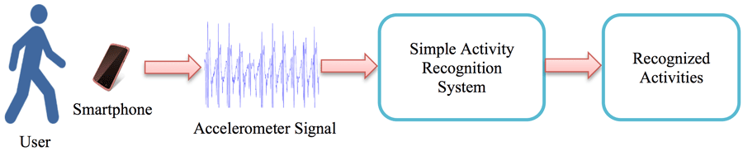
Method
We’ll train machine learning model, using a pre-labeled dataset.
Then use that model predict activities of testing dataset.
Sensor data

Slide 5
Accelerometer :
Source : wikipedia
An accelerometer is a tool that measures proper acceleration. Proper acceleration is the acceleration (the rate of change of velocity) of a body in its own instantaneous rest frame; this is different from coordinate acceleration, which is acceleration in a fixed coordinate system. For example, an accelerometer at rest on the surface of the Earth will measure an acceleration due to Earth's gravity, straight upwards (by definition) of g ≈ 9.81 m/s². By contrast, accelerometers in free fall (falling toward the center of the Earth at a rate of about 9.81 m/s²) will measure zero.
Gyroscope :
Source : wikipedia
A gyroscope is a device used for measuring or maintaining orientation and angular velocity. It is a spinning wheel or disc in which the axis of rotation is free to assume any orientation by itself. When rotating, the orientation of this axis is unaffected by tilting or rotation of the mounting, according to the conservation of angular momentum.

Slide 6
Dataset
We have collected dataset for this project from UCI ML Repository.
Experiments have been carried out with a group of 30 volunteers within an age bracket of 19-48 years.
Activities that have been recognised are as follows:
WALKING, WALKING_UPSTAIRS, WALKING_DOWNSTAIRS, SITTING, STANDING, LAYING
3-axial linear acceleration and 3-axial angular velocity at a constant rate of 50Hz:
Triaxial acceleration from the accelerometer (total acceleration) and the estimated body acceleration.
Triaxial Angular velocity from the gyroscope.
A 561-feature vector with time and frequency domain variables.
Its activity label.
An identifier of the subject who carried out the experiment.

Slide 7
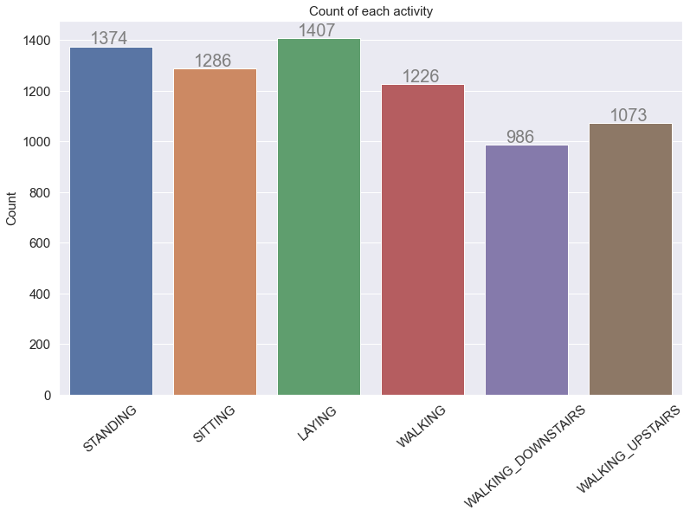
This is the count of all the activities in dataset we used for this project.

Slide 8
Progress
We started our project by reading literatures on the work that had already been done.
We took the dataset and read the literature by owner of the dataset to better understand the dataset.
Further, we took help matplotlib to visualize the dataset.
Then we started working on feature selection part as the original dataset contain 561 features, we experimented by removing some features in order to optimize the performance and then we applied algorithms to see the result and we are still working on it.
Further we have planned to train different model with different set of features and then use a voting system to finally produce the output.

Slide 9
Algorithms
These are the algorithms we used in this project:
Logistic regression
Linear SVM
Decision Trees
Random Forest
K-Nearest Neighbors (KNN)

Slide 10
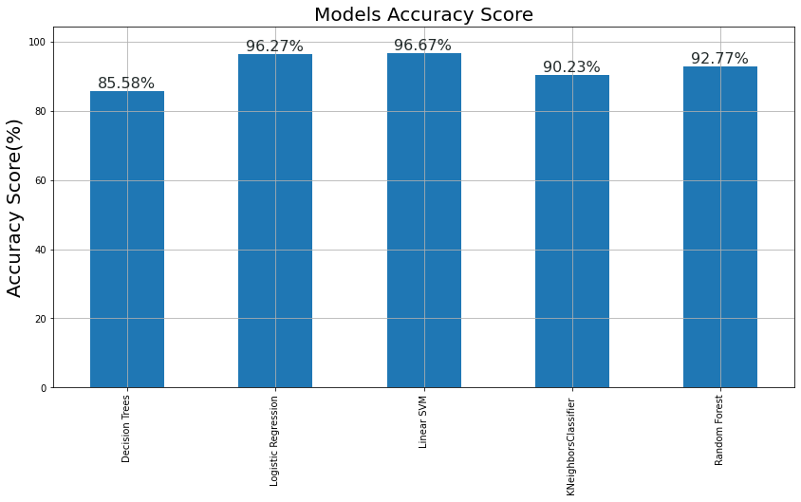
Outcomes
After training and testing of our model these are the results:

Slide 11
Timeline
Task 1 . Sept 15 - 23, 2020 ( 1 Week )
Search / Download dataset.
Prepare synopsis describing problem, proposed solution, expected algorithm & outcome.
Task 2. Sept 24 - 30, 2020 and Oct 15 - 20, 2020 ( 2 weeks )
Read research papers on the work that has already been done on the problem.
Find inferences from the papers and understand the procedure to solve the problem.
Report on research papers read.
Task 3. Oct 21 - 28, 2020 ( 1 week )
Implement selected papers.
Report findings of the implementation.

Slide 12
Task 4. Oct 29 - Nov 20, 2020 ( 2 weeks )
Design own model for the problem.
Task 5. Nov 20 - 30, 2020 (1 week )
Implement the proposed model.
Test the model.
Task 6. Nov 30 - Dec 05, 2020 ( 1 week )
Write a paper on the project

Slide 13
Limitations and future scope
A complete representation of human activities and the corresponding data collection and annotation is still a challenging and unbridged problem. In particular, we may conclude that despite the tremendous increase of human understanding methods, many problems still remain open, including modeling of human poses and annotating data.
Our model can be further used in making a Fall Detection model. Since, Fall is also a kind of human activity so it can further added in our HAR model.
Fall detection will need more data for training and will be more complex than a HAR model.
For more accurate results we can also apply conventional neural networks(CNN) to the model.

Slide 14
References
Human Activity Recognition using Android Smartphone Usharani J, Dr. Usha Sakthivel PG Scholar, Professor and HOD, Department of Computer Science,RRCE.
Human Activity Recognition using Smartphone Sensor Data Nicholas Canova, Fjoralba Shemaj December 2016.
A Public Domain Dataset for HAR Using Smartphone Davide Anguita, Alessandro Ghio, Luca Oneto, Xavier Parra and Jorge L, Rayes-Ortiz.
Registration and Analysis of Acceleration Data to Recognize Physical Activity Marcin Kolodziej, Andrzej Majkowski, Pawel Tarnowski, Remigiusz J. Rak, Dominik Gebert, and Dariusz Sawicki
Google Youtube
Github Stackoverflow

